Slide 1

Predictive Analytics with R (Phase 2)
Final

Slide 2
Description
The purpose of this assignment is to explain “City of Chicago’s Data Portal”. This data is compiled from Chicago’s Criminal Database. As in Phase 1, our goal is to determine what different conditions/parameters can predict and explain If someone will or will not be arrested in the future. For Phase 2, we have run a few predictive models and can see what best predicts Arrest.

Slide 3
Predictive Analytics (1)
We want to predict Arrest using our language of choice – R.
We have many different items to compare if someone will be arrested, a few of those being:
The type of charge they acquired (FBI CODE)
The district/ward they committed the crime in, previously
If Domestic Violence played a role
The Hour, Month or Year

Slide 4
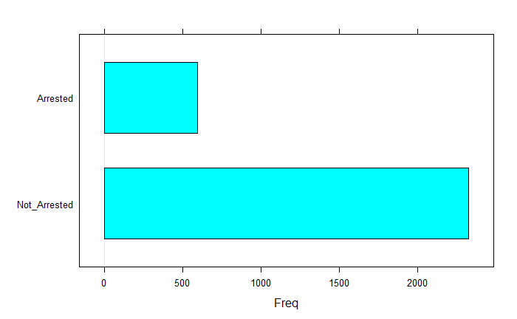
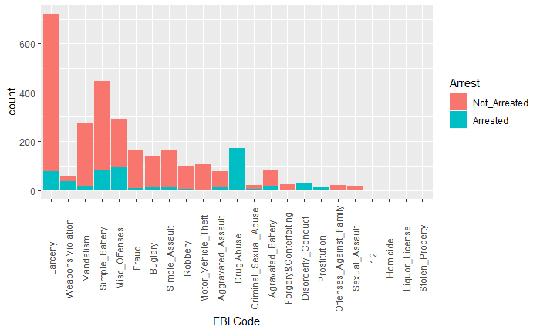
Predictive Analytics (2)
The Variable/Item that correlated with predicting future arrest the most is “FBI Code” or in other terms, what crime they committed.
This makes logical sense. If someone commits murder they are “usually” less empathic and will do what it takes to make ends meet.
From our report, we see that the four items of most importance are: Domestic Violence, Weapons Violation, Simple Battery, Disorderly Conduct and Drug Abuse.
We can also look at this on a time-frame based approach.
Did this happen in the month of December at 12PM?
We can see that roughly 4 times the amount of users have not been arrested compared to users that have been.

Slide 5
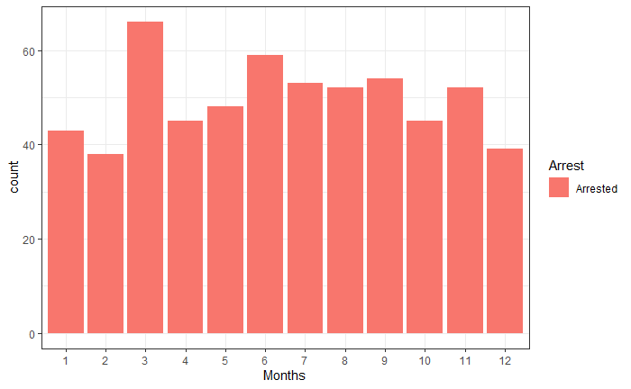
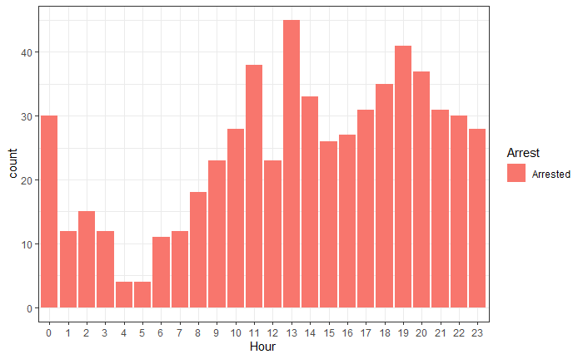
Predictive Analytics (3)
We can also see the peak Months and Hours during the day at which the users were arrested.
We can see that midnight and 1 PM were the times at which most arrest occurred.
We can also see that March and June had the highest peak of arrest. In the next slide we see it all come together.

Slide 6
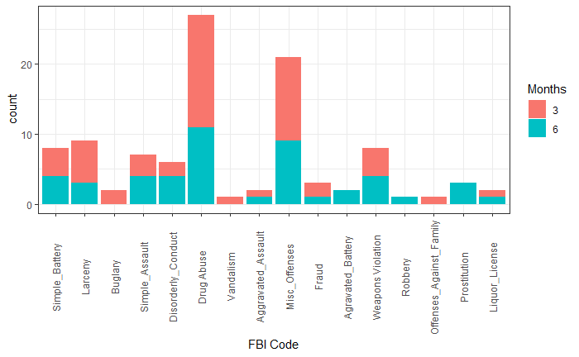
Summary
We see that with our predictive modeling, can compare and see what past experiences users need to do to either become arrested again or to stay outside the prison system.
We predicted that Domestic Violence, Weapons Violation, Simple Battery, Drug Abuse, Disorderly Conduct were key factors in determining the above, now let’s visualize this result.
We can see that within the month of March and June, users were Committing the above and thus proves our model to be worthwhile.

